Slide 1
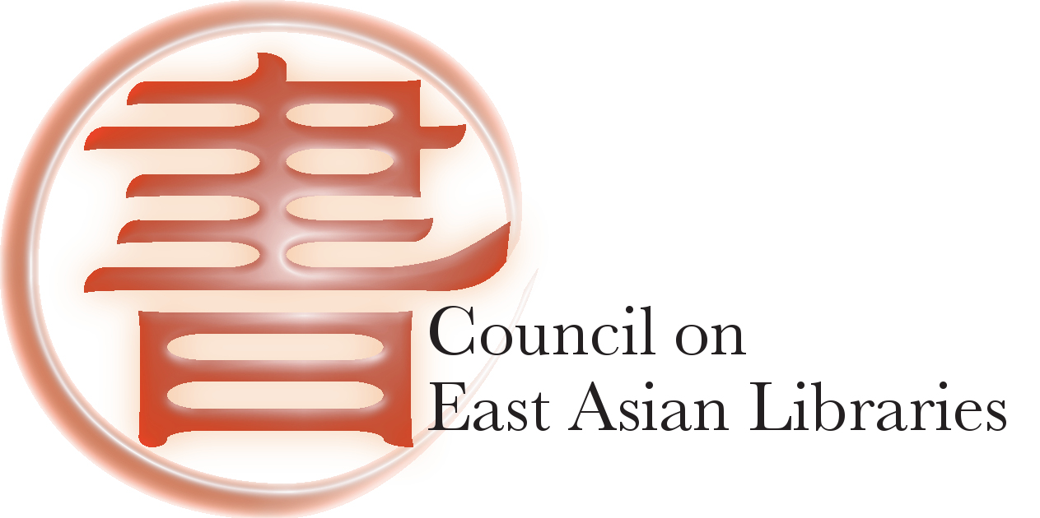

RDA Implementation
Current Status and Known Issues
CEAL CTP 2014 Program
RDA Implementation: Current Status and Known Issues
  • Survey report on RDA Implementation Status
  • Known Issues: Impact on users’ experiences & resource discovery
  • Known Issues: Suggested solutions and the committee’s priorities
  • LC Updates (distributed via eastlib-l)
  • PCC CJK NACO Project updates (distributed via eastlib-l)
  • Discussion
Report: ALA-LC Japanese Romanization Table
Report & Award: LC-CEAL Cataloging Internship Program
Report & Recognition of CTP members and subcommittee members
Q&A
Notes:
Dear all, Thank you for coming to CEAL Committee on Technical Processing Annual Program. In 2012 and 2013, we have workshops and programs on RDA trainings and RDA implementation. So after national implementation on March 31, 2013, CTP want to look together with CEAL members on where we are now with RDA implementation and any known issues at today’s program. We include LC update and CJK NACO Project Update that were distributed before the meeting, I hope that you have a chance read them. We also want to discuss and hear what CEAL members’ thoughts on these known issues. Follow the program, CTP will give brief updates on Japanese Romanization Table, LC-CEAL Cataloging Internship Program, as well as CTP’s final report. Now, I turn over the program to Charlene Chou, chair of CTP subcommittee on RDA, Let’s begin our program. Thanks.

Slide 2
“Extinction or Evolution”
Be Innovative and Proactive
CEAL CTP 2011-2014 Final Report
Prepared by Shi Deng, Chair with the CTP Members:
  Erica Chang
  Yoko Kudo
  Mieko Mazza
  Dongyun Ni
  Yue Shu
  Jai-hsya Tsao
  EunHee Nah (2011-2012)
  Hyun Chu Kim (2013-2014)
Notes:
Thanks to Charlene, Yoko, and Shu Yue for giving you update on some of CTP activities that have been done in the last three years. I will build on what they provided by giving you a brief final report.
In March-April 2011, I asked committee members to give me a brief statement what they want to contribute if they are selected to serve. One of members spoke about our future as catalogers. We are in the internet and digital age, our users need Google type of instant gratification. We can’t not live in our own world, we need to listen to our users, otherwise, we will cut off ourselves from real users. Our motto is “extinction or evolution”. Changing proactively is our only way to stay in the profession. Since then, we try to be innovative and proactive, and I want to thank her for that by using what she said to conclude this term of CTP.

Slide 3
CTP 2011-2014 Work Plan: Collaborating with other Committees
Joint Programs:
  With CPS on Discovery, Delivery, and Dissemination of Information in a Multilingual and Multicultural Environment (2012), on Open Access and Discovery (2013), and on Scholarly Networking (2014)
  With OCLC CJK User Group on RDA Implementation (2013)
Joint Workshops and Trainings:
  Joint Webinars with OCLC CJK User Group (2011-2012)
  Joint NACO Webinars (2011-12) and Workshops with CJK NACO Project (2013-14)
  Joint Workshop with CCM, CJM, CKM on E-Resources Metadata Standards and Best Practices (2014)
Joint Projects:
  With LC on LC-CEAL Cataloging Internship
  With CJM and CCM on Japanese and Chinese Romanization
  With Membership Committee on CEAL Technical Services Expertise List (2013-14)
Notes:
I also want to mention that some of CTP activities were initially brought up by CEAL members, such as the Task Force on E-resource Metadata Standards and Best Practices was brought by Bie-Hwa Ma, and CEAL Technical Services Expertise List was brought by Charlene Chou, also there were numerous RDA related issues were brought by CEAL members. Thank you!

Slide 4
CTP 2011-2014 Work Plan: Providing Trainings
RDA Trainings:
  Introduction (2012),
  Hands-on Training on both RDA Bibliographic and Authority (2013)
  More RDA NACO Trainings (2014)
Other Trainings
  Webinar on Searching NACO Authority File in OCLC (2011)
  Webinars on NACO References for Personal Names and Corporate Bodies (2012)
  Webinar on Subject Cataloging Using LCSH (2012)
  Webinar on Chinese Rare Book Cataloging (2012)
  Workshop on E-resource Metadata Standards and Best Practices (2014)

Slide 5
CTP 2011-2014 Work Plan:
Working on Projects
RDA Related Projects:
  RDA Proposal on Chinese place names (RDA 16.2.2)
  RDA CJK special issues on RDA 1.8 Numbers Expressed as Numerals or as Words
  CEAL Response to 6JSC/ISSN/2 [Major title changes for serials in Chinese, Japanese and Korean (RDA 2.3.2.13.1, ISBD A.2.6.1 and ISSN 2.3.1)]
  RDA Relationship Designators: Discussion concerning application of RDA relationship designators to CJK rare book cataloging
  RDA NACO Conversion Preparation: Review Terms in $c in Personal Name
  RDA NACO Undifferentiated Personal Names: Response to PCC with collective feedback from a community survey
  CTP Subcommittee on RDA on known issues

Slide 6
CTP 2011-2014 Work Plan:
Working on Projects (cont.)
Annual Programs and Workshops Planning
Japanese and Chinese Romanization
  Japanese Romanization: ALA-LC Romanization Table revision
  Chinese Romanization: ISO/CD 7098 Revision
LC-CEAL Cataloging Internship Program
Electronic Resources Metadata Standards & Best Practices
CTP Website Redesign and Maintenance
Please See the CTP 2011-2014 Project Page for Details
http://www.eastasianlib.org/ctp/projects.htm

Slide 7
Thank You for Your Leadership, Contributions, and Participation!
CTP Members | RDA Trainers | Subcommittee on RDA | RDA Proposal on Chi Place Name | Other RDA Projects
Shi Deng (Chair) | Charlene Chou (Leader) | Charlene Chou (Chair) | Sarah Elman (Chair) | Shuwen Cao
Erica Chang | Erica Chang | Erica Chang | Rob Britt | Erminia Chao
Hyun Chu Kim | Erminia Chao | Erminia Chao | Shi Deng | Charlene Chou
Yoko Kudo | Sarah Elman | Rob Britt | Vickie Doll | Sarah Elman
Mieko Mazza | Hideyuki Morimoto | Shi Deng | Lauran Hartley | Lauran Hartley
EunHee Nah | Jee-Young Park | T.J. Kao | Zehua Sun | Bie-Hwa Ma
Dongyun Ni | Jai-Hsya Tsao | Mieko Mazza |  | Hideyuki Morimoto
Yue Shu | Jessalyn Zoom | Jee-Young Park |  | Jee-Young Park
Jai-Hsya Tsao |  | Hideyuki Morimoto (Consultant) |  | Ai-Lin Yang
 |  | Sarah Elman(NACO) |  | Julie Su
 |  | Jessalyn Zoom (LC) |  | CTP members
Thank You to CEAL Members and CEAL EB Members for Participation and Support!

Slide 8
Thank You for Your Leadership, Contributions, and Participation!
LC-CEAL Internship | Japanese Romanization | Chinese Romanization | ER Metadata Standards | Webinar Trainings
Yue Shu (Chair) | Keiko Suzuki (TF Chair) | Shi Deng (Chair) | Bie-Hwa Ma (Co-Chair) | Shi Deng (Coordinator)
Erica Chang | Yoko Kudo (WG Chair) | Vickie Doll | Chengzhi Wang (Co-Chair) | Hideyuki Morimoto (Trainer)
Yoko Kudo | Rob Britt | Sarah Elman | Erica Chang | Jessalyn Zoom (Trainer)
EunHee Nah | Mieko Mazza | T.J. Kao | Charlene Chou | Haihui Zhang (Trainer)
 | Hikaru Nakano | Dongyun Ni | Shi Deng | Shuwen Cao
CTP Website Redesign | Chiaki Sakai (WG) | Ming-sun Poon | Miree Ku | Sarah Elman
Yoko Kudo (Leader) |  | Jia Xu | Connie Lam | Shuyong Jiang
Dongyun Ni (Webmaster) |  | Susan Xue | Mieko Mazza | Sharon Domier
Yue Shu (Webmaster) |  |  | Haruko Nakamura
Shi Deng |  |  | Susan Xue
Thank You to CEAL Members and CEAL EB Members for Participation and Support!

